Slide 1
DATABASE DESIGNE AND DEVELOPMENT PROJECT PROJECT
PROJECT TITLE:MATATU SACCO
MEMBERS:
1.FELIX OCHIENG-24/06618
2.JESSE BISONGA
3.

Slide 2
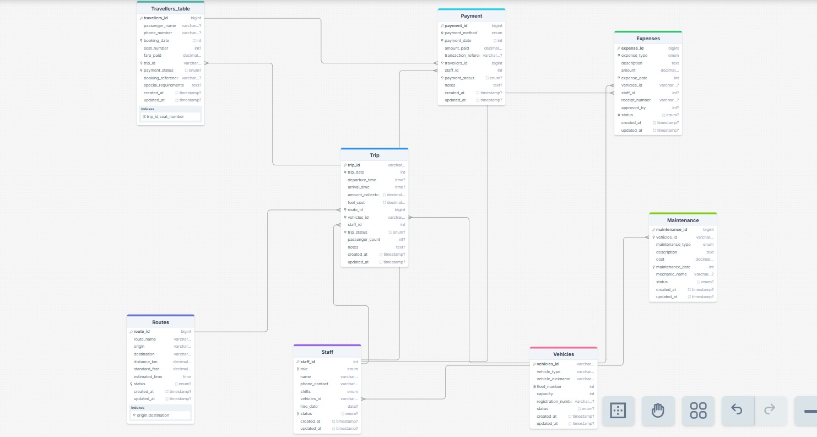
DATABASE ERD DIAGRAM

Slide 3
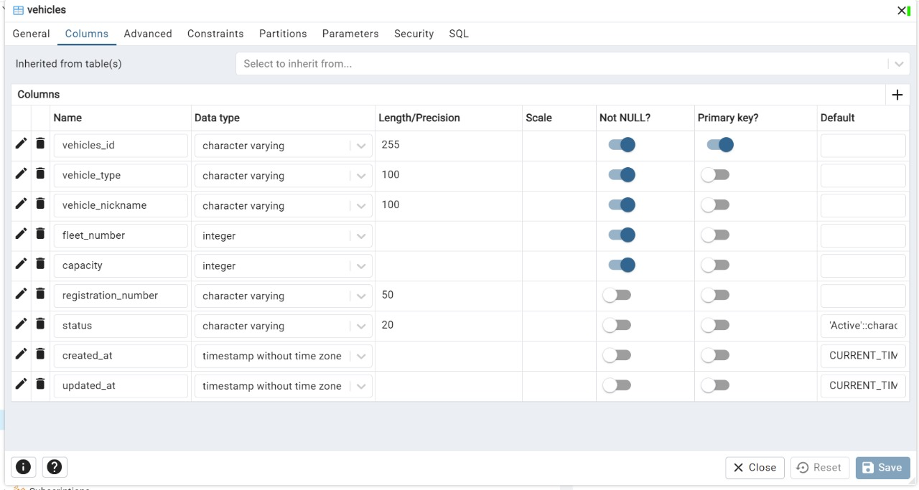
TABLE 1:VEHICLES

Slide 4
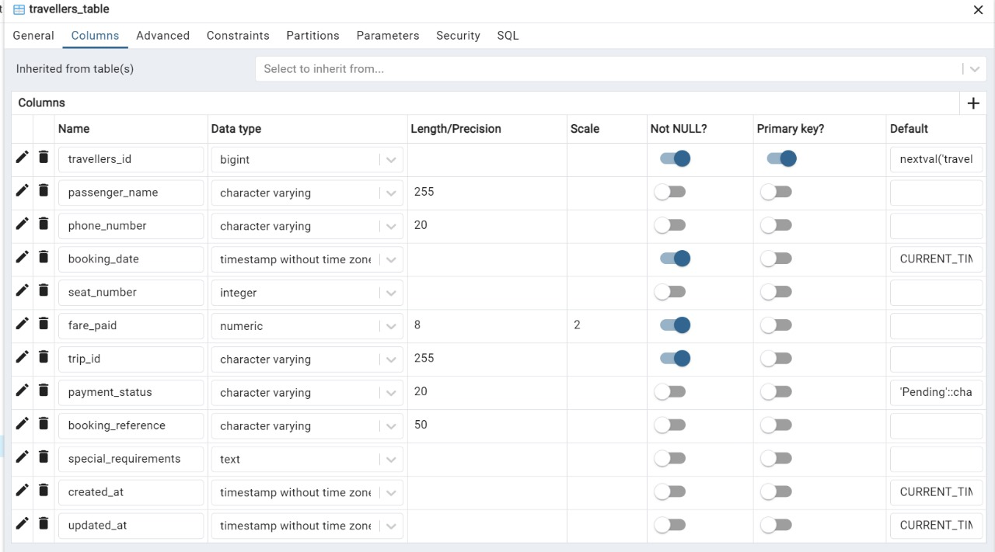
TABLE 2:TRAVELLERS

Slide 5
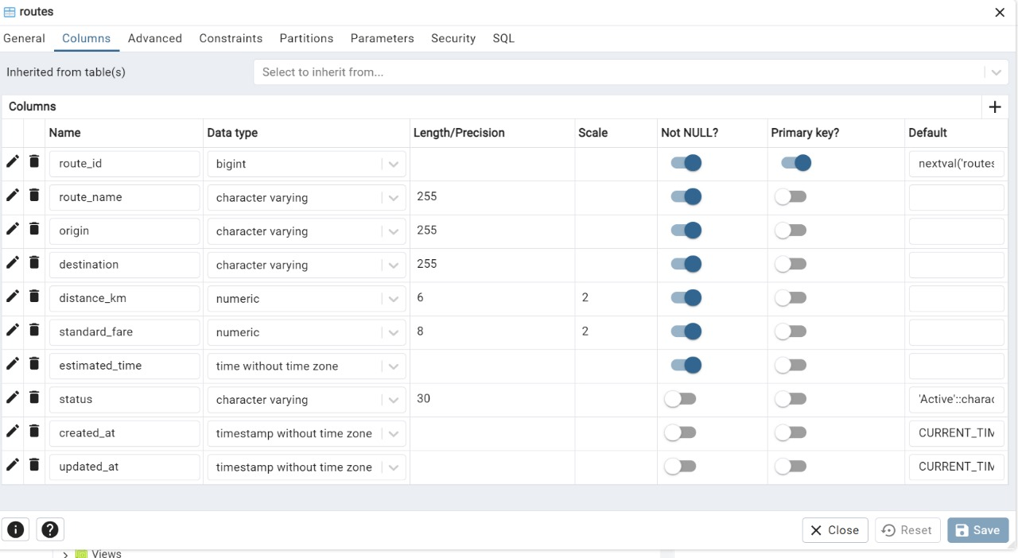
TABLE 3:ROUTES

Slide 6
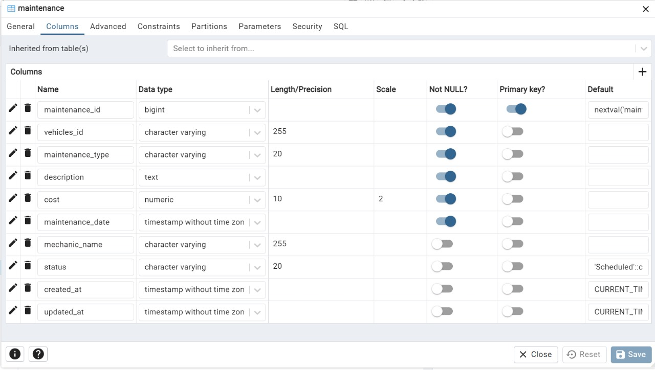
TABLE 4:MAINTENANCE

Slide 7
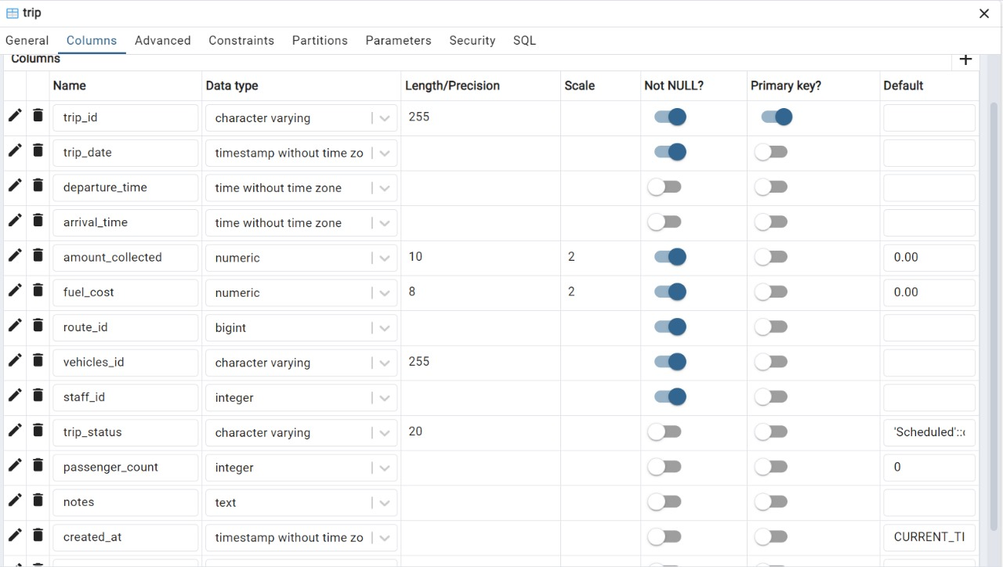
TABLE 5:TRIPS

Slide 8
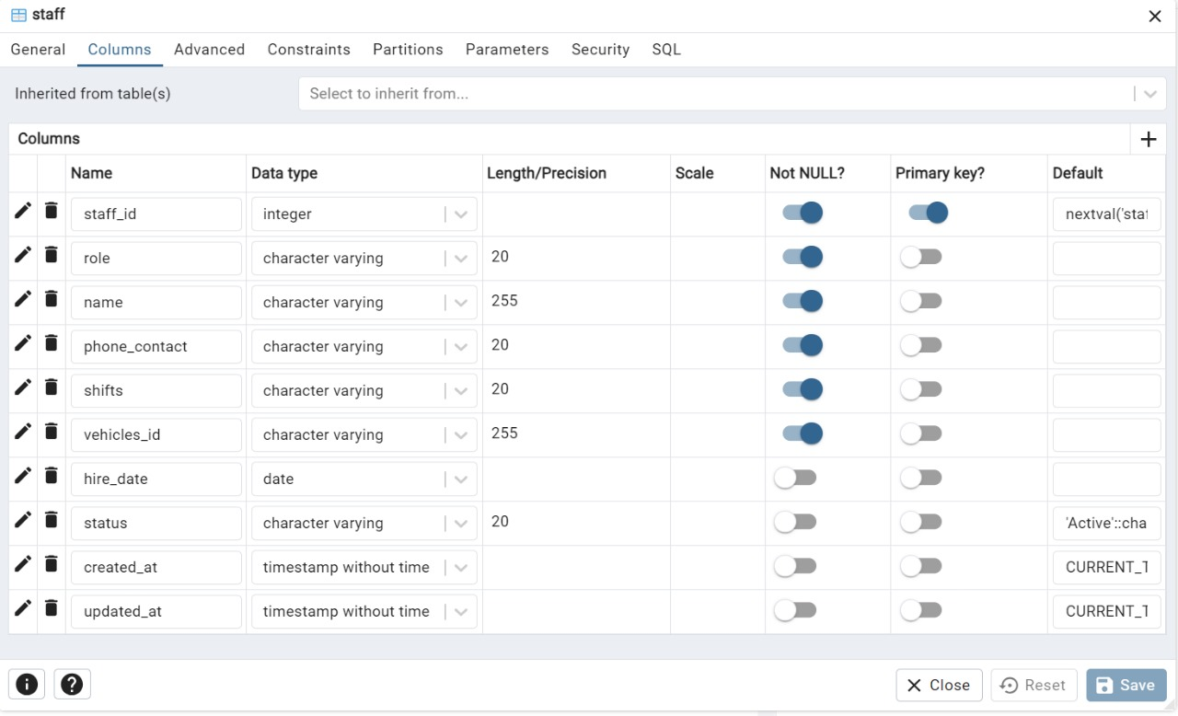
TABLE 6:STAFF

Slide 9
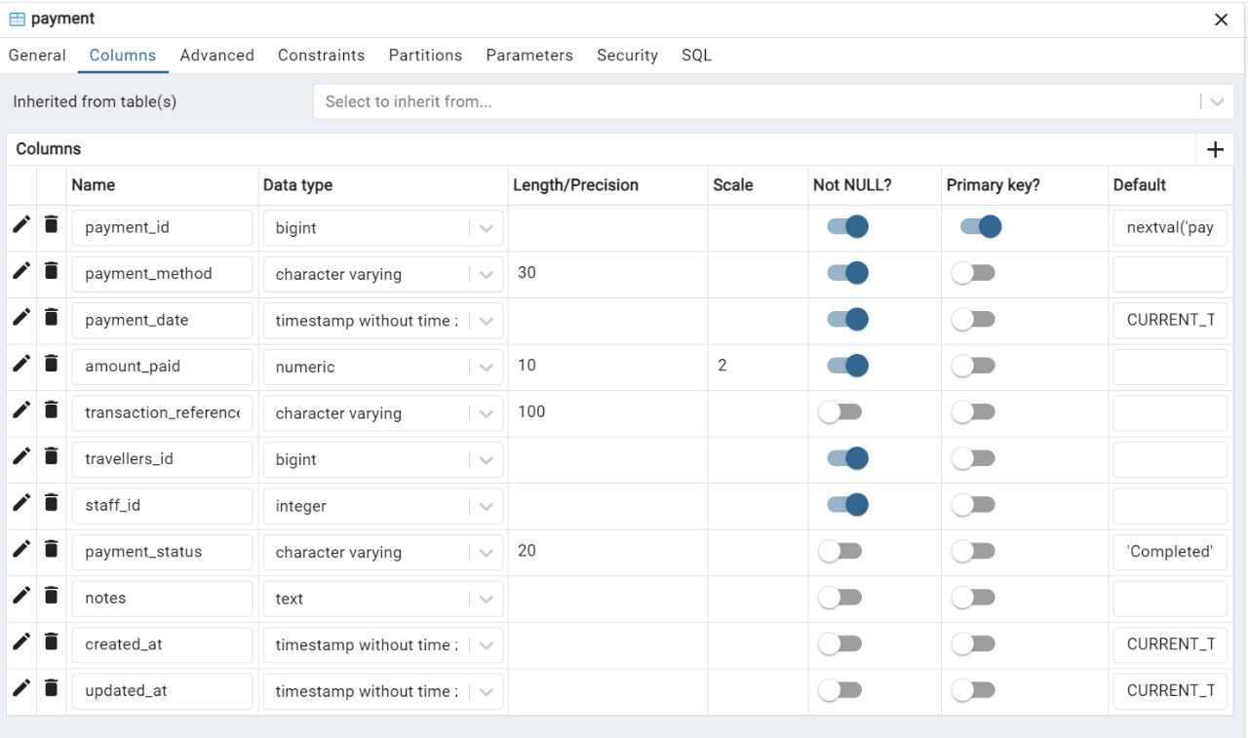
TABLE 7:PAYMENTS

Slide 10
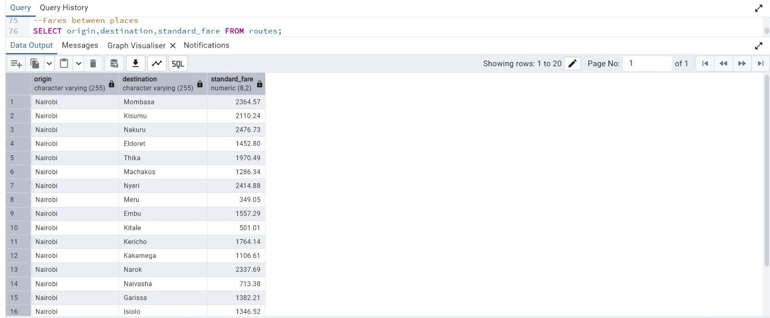
QUERIES

Slide 11
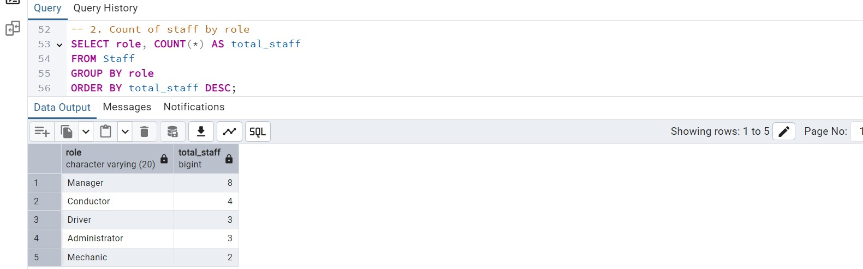
QUERY 2

Slide 12
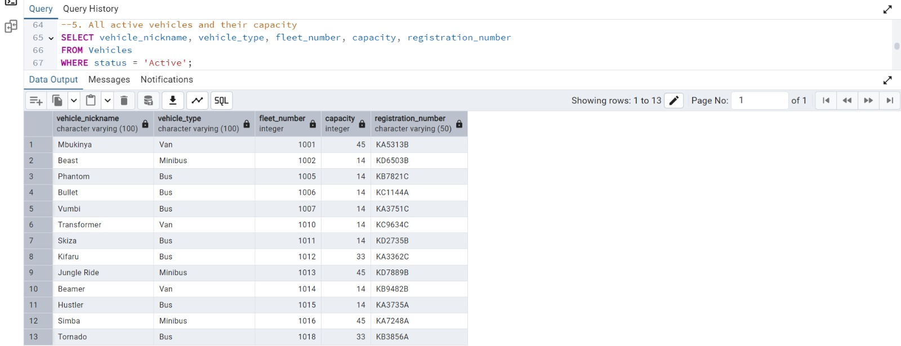
QUERY 3

Slide 13
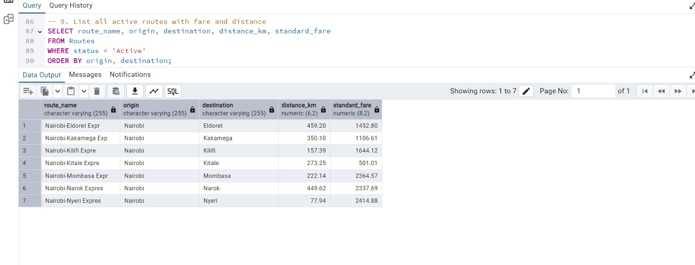
QUERY 4

